Slide 1
Arrangements for SRA regulation of CILEX members

Slide 2
Overview - key SRA proposals
Regulatory standards – covering authorised CILEX members under a separate Code of Conduct, and reauthorising CILEX firms as SRA firms
Education and authorisation – keeping a distinct identity for CILEX members
Enforcement, including a joined-up approach where CILEX members work in SRA firms

Slide 3
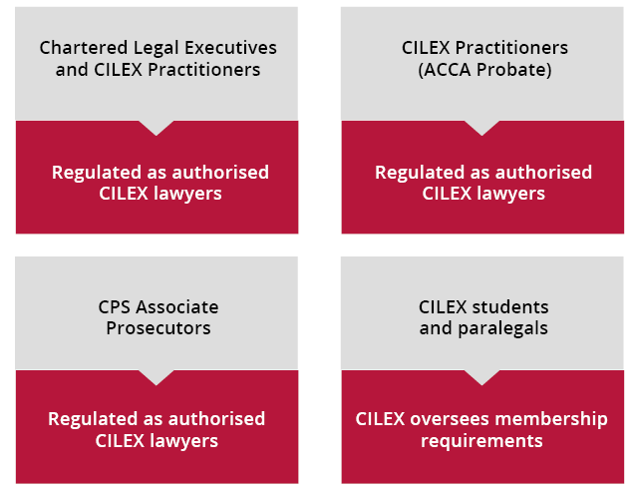
Regulatory standards - individuals

Slide 4
SRA CILEX Code of Conduct
Principles based on the core principles in the current CILEX Code of Conduct
Requirements aligned with the Code for Solicitors, including on client information, managing conflicts, reporting to us
Authorised CILEX lawyers and solicitors regulated to similar high professional standards

Slide 5
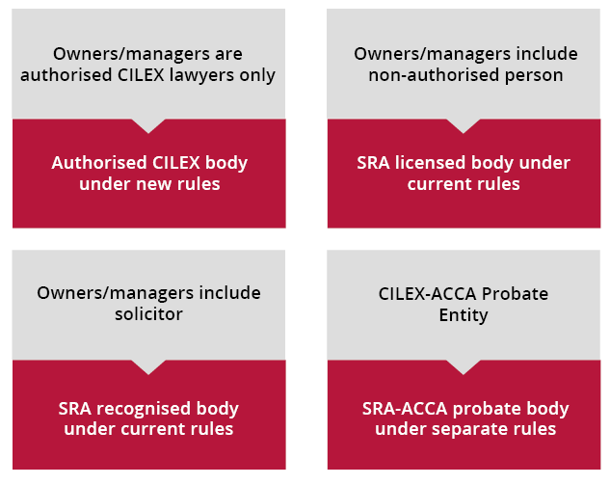
Regulatory standards - firms

Slide 6
Education and authorisation
Keeping a clear separate CILEX route to becoming an authorised legal professional
Authorisation decisions:
who takes decisions
rights of review and appeal
Continuing competence – evolving our action plan for solicitors to cover authorised CILEX lawyers

Slide 7
Investigation and enforcement
Powers and controls over authorised CILEX lawyers
Harmonised with existing powers over people working in SRA firms
status of authorised CILEX lawyer will be the primary grounds for action
Disciplinary decisions:
who takes decisions
rights of review and appeal
publication of decisions and costs

Slide 8
Client protection and consumer information
CILEX firms reauthorised as SRA firms
Indemnity insurance – required minimum coverage for incorporated firms rising from £2m to £3m
Client access to SRA Compensation Fund:
will require law change to cover firms owned and managed only by CILEX lawyers
interim arrangements underwritten by CILEX
SRA consumer information rules will apply

Slide 9
Consultation and contact details
Read the consultation paper and respond online: https://www.sra.org.uk/regulation-cilex-members
Consultation closes on 22 November 2023
Questions? Please contact us at: cilexconsultation@sra.org.uk

Slide 10
Questions?

